Slide 1
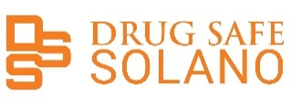
Drug Safe Solano A Brief History Colleen Townsend, MD Partnership HealthPlan of California

Slide 2
Solano Opiate Data 2014
Opioid Prescription rates 800,000 per 1,000 residents
Buprenorphine Prescriptions less than 10 per 1,000 residents
Opioid Overdoses – 4 / 100,000 residents
Notes:
Opiate RX – had risen as in other part of CA and the US in the early 2000’s peaked in 20112- 2016
Buprenorphine prescriptions in the county are used to gauge the expansion of medication-assisted treatment (MAT). The annual buprenorphine prescribing rate in 2018 was 17.5 per 1,000 residents. This represents a 9% increase in buprenorphine prescribing from 2016.
Footnotes: 12-month rates are based on moving averages; OD = Overdose; Qtrly = Annualized Quarter
Report produced by the California Opioid Overdose Surveillance Dashboard - https://cdph.ca.gov/opioiddasboard

Slide 3
Background
2014-2017 Solano County Community Response emerges
2014-2016 PHC prescribing guidelines developed and implemented
2016- 2017 Grand Jury Report suggest formation of an Opioid Safety Coalition to address Opiate Use and abuse in Solano County
2018 Solano Coalition for Better Health drives the formation of the Solano Opioid Safety Coalition -- Med Mark Treatment Centers provides funding
March 2018, Collaborative Court convenes a community-wide meeting to address opioid addiction issues in our community
September 13, 2018 -- The Solano Opioid Safety Coalition was officially launched
July 2019 – Drug Safe Solano
Notes:
To address the Opioid issues in Solano County the medical and community leaders started to meet for about three years with PHC and Kaiser convening providers to develop opioid safe prescribing guidelines for their providers. There are several prescribing guidelines available on the PHC website.
In 2017 the Grand Jury report highlighted the need for the creation of a Opioid Coalition to address opioid addiction issues in a coordinated approach.
Additionally on March 29, 2018, the Collaborative Court bought together about 50 folks from various government agencies, hospitals and medical systems, law enforcement, treatment, schools and the county who are interested in addressing opioid addiction issues.
MedMark treatment Centers received a grant from SAMHSA to provide HUB & Spoke services to individuals who are addicted to opioids and provided SCHB with generous start-up funding to create the Opioid Coalition in the FALL of 2018.

Slide 4
Drug Safe Solano
Community collaborative with a broad representation of a cross-section of the community, civic government and agencies, hospitals and medical providers
Consensus driven activities aimed at improving opiate safety with regard to opiate use in Solano County
Notes:
The Solano Coalition for Better Health was the lead agency working with its partners to reduce the number of individuals who are prescribed opioid medications and to improve medication safety and treatment strategies
DSS has built a robust coalition with over 50 members from a cross-section of local hospitals, community health centers, law enforcement, courts, county agencies, community-based organizations, first responders and concerned residents.

Slide 5
Creating change through Action
Safer Prescribing Practices
Increase Access to Naloxone
Increase Access to Medication Assisted Treatment (MAT)
Increase awareness of risks associated with opiates throughout Solano communities: health care, residents, businesses and non profits
Building sustainability
Notes:
Sustainability- we have written a couple of grants, funded by Kaiser for sponsorship grant, CA Department of PH, County Behavioral Health, PHC, CA Accelerator Safety Network , we need to develop a sustainability plan , held some meetings with local leaders to educate them about DSS our goals and needs.
NorhtBay provides in-kind support by allowing us to hold our monthly coalition meetings in their training facility
Kaiser and other DSS practitioners lend their clinical expertise to help inform our strategies
Touro –space for VISTA, administrative support

Slide 6
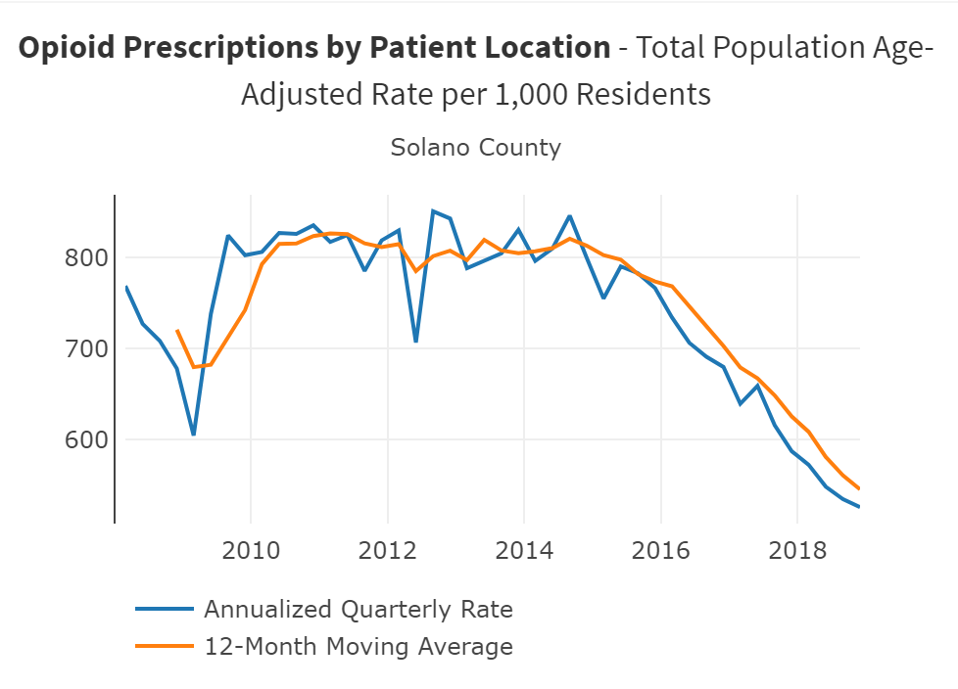
Notes:
Safer Prescribing – Prescribing rates are down 20% from 2016
2018 277,436 opioids prescriptions
621.2 prescriptions / 1,000 Solano county residents

Slide 7
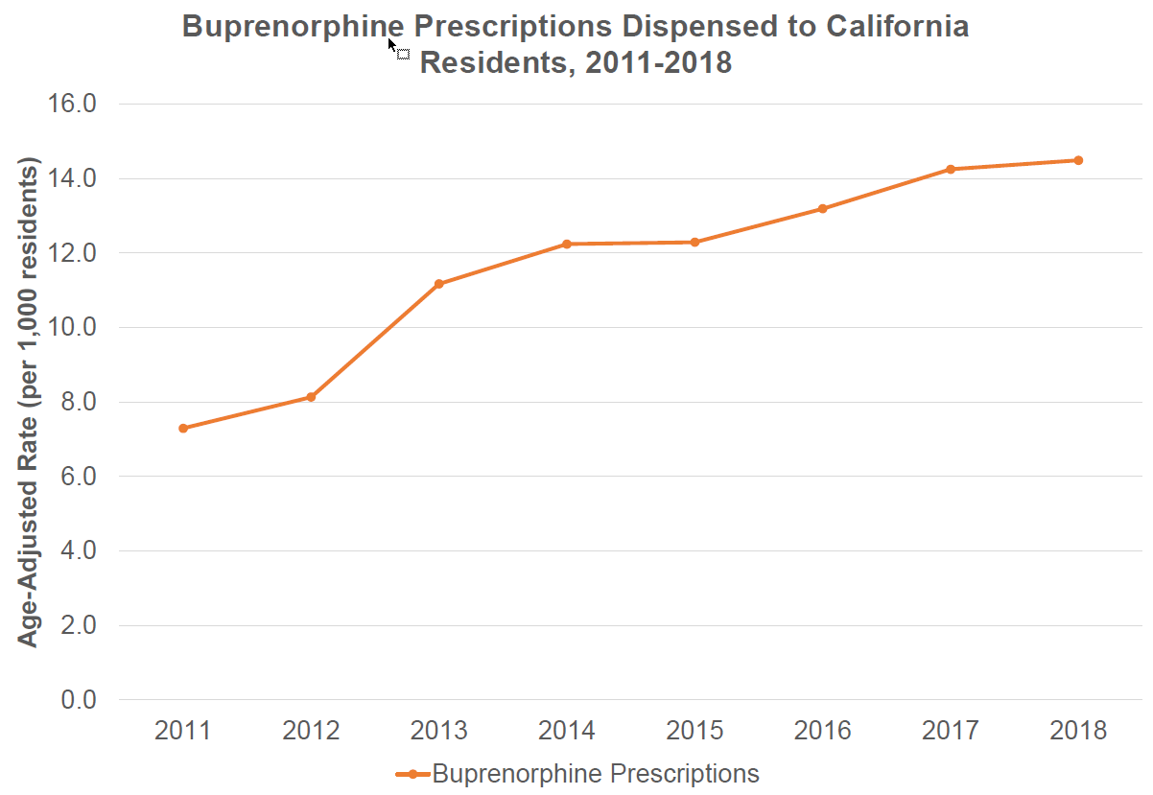
Notes:
Increasing Access to Treatment – MAT up 9 %from 2016
Buprenorphine Prescribing date up to 17.5/1000 residents

Slide 8
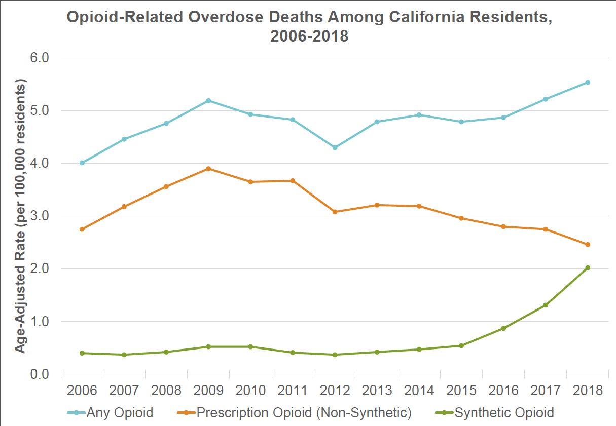
Notes:
Opioid Overdoses and deaths
19 deaths due to all opioid related overdoses ( up from 14) – 25% increase overall from 2016
We have also seen a rise in Synthetic ( Fentanyl) Opiate deaths up 50% since 2017
2017 – 2018 150% increase in Solano county in heroine over dose deaths
Mortality Rate 4.3/ 10,000 residents – up 25% from 2016

Slide 9
Celebrate Successes and we are not finished yet…
Continue to raise community and clinician awareness regarding pain management strategies that decrease the use of opiates
Increase access naloxone and safer storage practices
Increase systems of care and remove barriers to increase access for treatment on demand for Opiate Use Disorder
Ongoing collaboration that builds systemic changes that persist beyond the current crisis

