Slide 1
NALOXONE: OUR SHIELD AGAINST THE OPIOID-OVERDOSE EPIDEMIC
Christina Kinnevey, MD
(Some slides adopted from Mohamed Jalloh, PharmD)

Slide 2
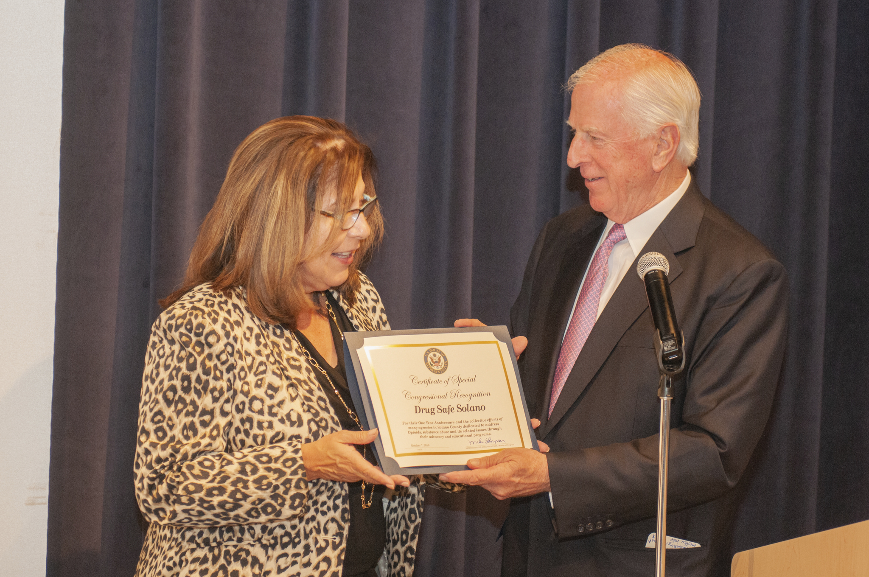
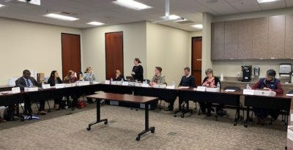
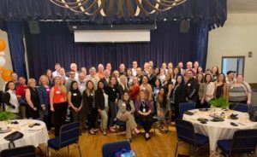

Slide 3
#1 Developed Action Teams
DSS Action Teams
Increasing Naloxone Availability
Increasing MAT Access
Lowering Opioid Prescribing Rates
Community Education and Primary Prevention
Sustainability
Notes:
One of the first accomplishments DSS made was create 5 action teams to better address the opioid crisis from every angle. We didn’t just want to focus on treating current people suffering from the disease without also addressing community education and prevention. Collectively, these action teams are composed of over 50 stakeholders in the community, passionate about making meaningful change. Each action team meets monthly.
Developed action teams focusing on prevention, reducing numbers of opioid prescriptions, increasing access to Medication Assisted Treatment (MAT) for opioid use disorder, and enhancing distribution of the life-saving drug Naloxone and training to various professional groups, such as physicians and first responders.
1)Lowering opioid prescription rates: academic detailing of high prescribers and educate prescriber community
2)Increasing access to Medication Assisted Treatment: increase access in primary care, the jail and emergency rooms
3)Increasing naloxone availability: polling law enforcement, pharmacies, schools and libraries on naloxone availability
4)Primary Prevention: provide education to the community and providers about the dangers of opioid addiction
5)Sustainability: Secure at least two new grants in the next 6-12 months.

Slide 4
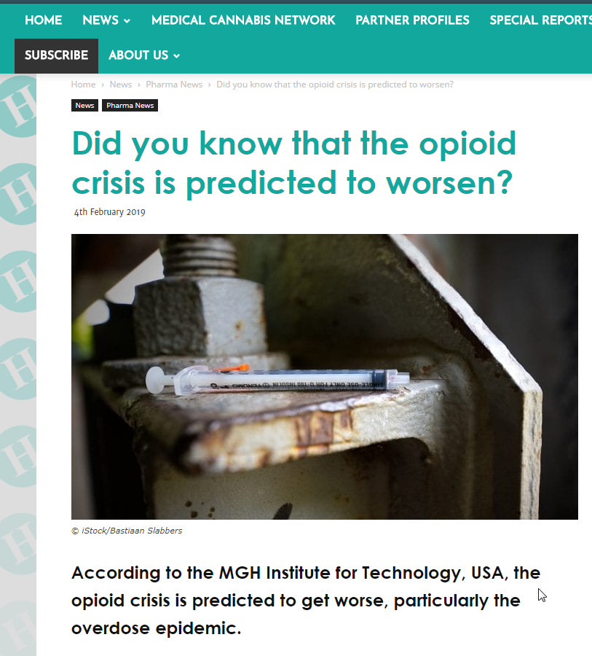
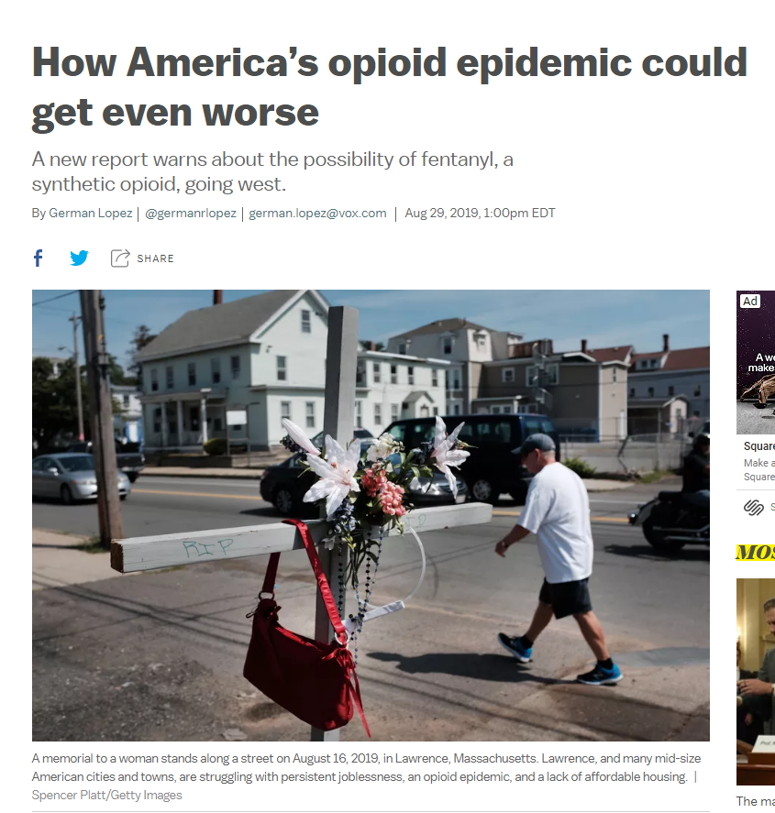
Notes:
https://www.healtheuropa.eu/opioid-crisis/90093/
https://www.vox.com/policy-and-politics/2019/8/29/20836719/opioid-epidemic-fentanyl-rand-report

Slide 5
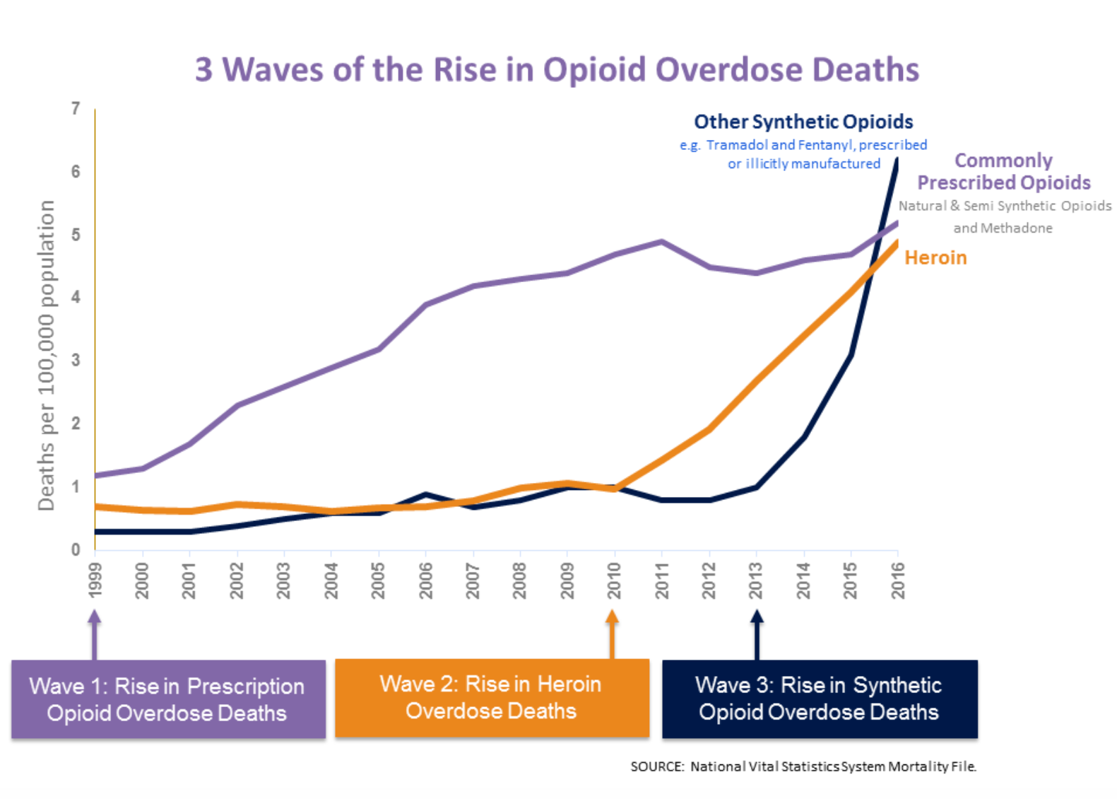
The Third Wave

Slide 6
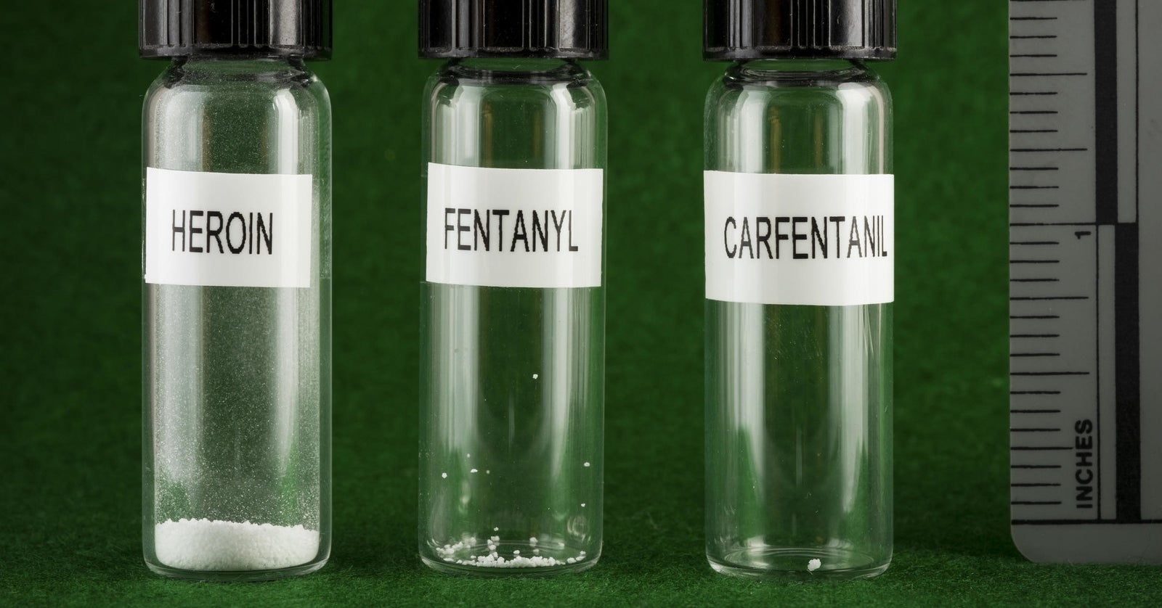

Slide 8
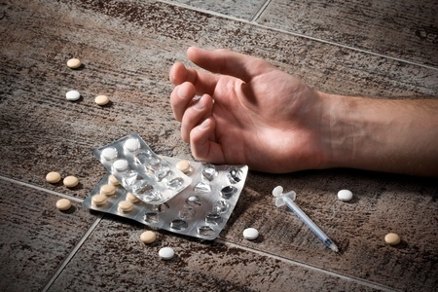
Overdose Risk Factors
Change in Tolerance
Just out of jail or rehab
Tapering from opioids
Physician no longer willing to prescribe
Mixing Drugs, particularly ones that are sedating (benzos, alcohol)
Many are more powerful when combined than when used alone!
Physical Health (liver failure weight loss, COPD, asthma, immune system problems, dehydration, malnutrition, etc.)
Quality and Potency of Opioid-- Variation in strength or content
Not all prescription opioids are equal in strength
Switching Route of Administration, such as from oral administration to snorting, smoking or injection.
Using Alone. Most fatal overdoses happen when people are alone, usually at home.

Slide 9
MECHANISM OF OPIOID OVERDOSE

Slide 10
SYMPTOM PRESENTATION AND DIAGNOSIS

Slide 11
😒

Slide 12
😒

Slide 14
Notes:
Give 2 slow rescue breaths into the person's mouth. Give 1 breath every 5 seconds until the person can breathe on their own.

Slide 15
Notes:
Give 2 slow rescue breaths into the person's mouth. Give 1 breath every 5 seconds until the person can breathe on their own.

Slide 21
Notes:
Combative or aggressive
Opioid withdrawal symptoms can occur after administering Naloxone
Rapid reversal may precipitate acute symptoms causing vomiting, agitation, delirium, seizures, hypertensive emergencies and ventricular arrhythmias

Slide 22
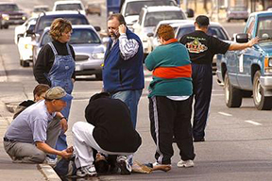
Good Samaritan Law
AB 472, California’s 911 Good Samaritan law, provides limited protection from arrest, charge and prosecution for people who seek emergency medical assistance at the scene of a suspected drug overdose.
What does this mean?
Many overdose deaths are preventable, yet people often fear arrest if they call 9-1-1 for help at the scene of a drug overdose. Good Samaritan Laws are designed to encourage people to seek medical care for the overdose victim by providing limited protection from arrest, charge, and/or prosecution for low-level drug violations.
Good Samaritan laws also offer general protection to anyone who attempts to help someone in emergency situations

Slide 23
NALOXONE ACCESS
California Assembly Bill (AB)2760 requires providers to prescribe naloxone to all patients who have a prescription for opioids exceeding 90 morphine mg equivalents or patients who receive concurrent opioids and benzodiazepines
Private insurance is okay with pharmacists to dispense without prescription. Medi-Cal (Partnership Health Plan) wants Rx from prescriber to pay for it
California Assembly Bill (AB)1535 permits pharmacists to furnish naloxone at pharmacy WITHOUT prescription

Slide 24
INFORMATION SESSION REVIEW
Opioid overdose is overconsumption of opioids that may cause respiratory depression or even death
Naloxone is the key medication to reverse opioid overdoses

Slide 25
Practice
Get in groups of 3-4 people around you
Practice going through the steps of responding to someone you encounter who is likely overdosing on opioids

Slide 26
THANKS!
😉
Any questions?
You can find me at
ckinnevey@solanocounty.com

